Slide 1


Building a Natural Language Query System on Unstructured Data using Knowledge Graphs
Team Members
Alex Kita, Arnav Saxena, Elin Kim, Ridwan Olawin, Shashwat Singh
Mentors
Mr. Satish Banka, Mr. Rajkumar Subramanian

Slide 2

Index
Problem Statement
Solution Overview
Solution Components
Data collection & Cleaning
Triple generation
Ontology generation
Natural Language to SPARQL Query generation
App Development
Demo of UI

Slide 3
Problem Statement

Slide 4
Knowledge based industries such as consulting derive a lot of value from unstructured data sources such as reports, filings, presentations etc
Currently, by large if any information needs to be extracted from these sources, it’s done in a manual fashion - not efficient

Slide 5
Knowledge based industries such as consulting derive a lot of value from unstructured data sources such as reports, filings, presentations etc
Currently, by large if any information needs to be extracted from these sources, it’s done in a manual fashion - not efficient
Solution
A knowledge-graph based question answering system

Slide 6
Solution Overview

Slide 7
Part I
Building Knowledge Graph
Data collection & cleaning
Triple generation
Ontology construction

Slide 8
Part I
Building Knowledge Graph
Part II
Querying System
Data collection & cleaning
Triple generation
Ontology construction
Natural Language Questions to SPARQL query conversion system

Slide 9
Data Collection & Preprocessing

Slide 10
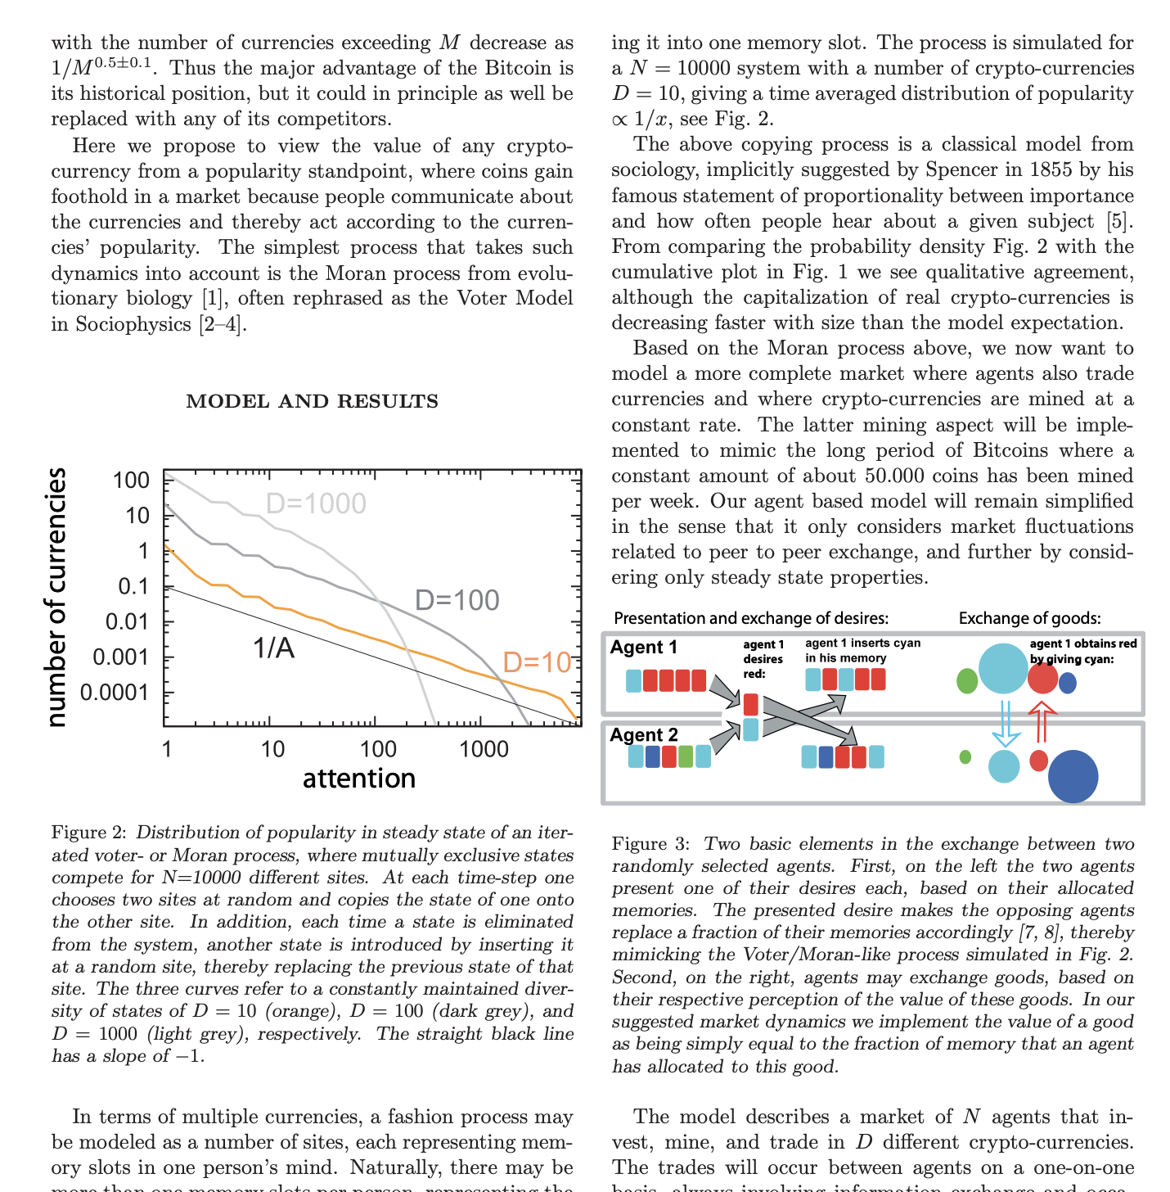
Information Extraction from PDF documents
Dataset
arXiv research paper dataset
cryptocurrency domain
Diverse formats of research papers
text extraction libraries such as PyPDF2 and PyMuPDF do not generate quality text, which results in serious cascading issues for the rest of the process
Required to understand the structure of each documents

Slide 11
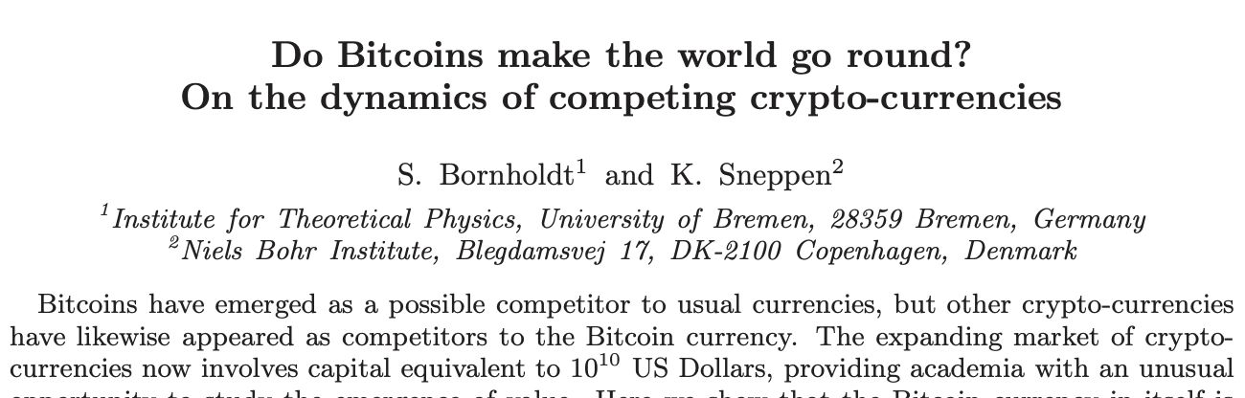
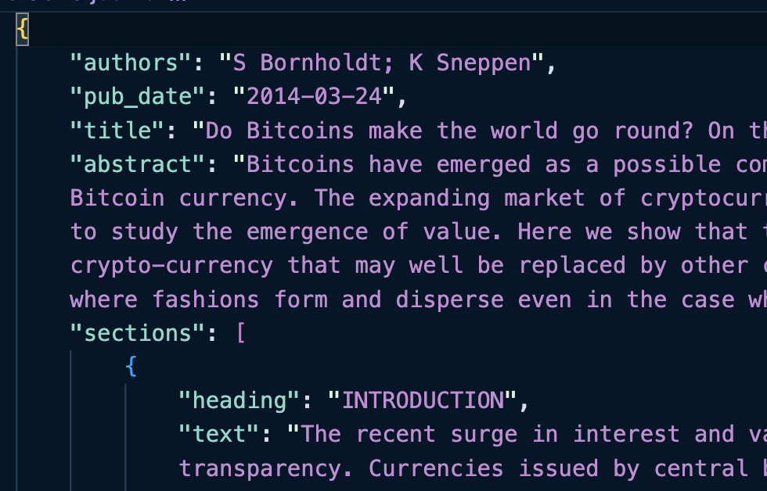
Information Extraction from PDF documents
Leveraged an ML-based parser
GROBID
Header extraction and parsing from article in PDF format.
Generate bibliographical information (e.g. title, abstract, authors, affiliations, keywords, etc.) and sections.
Used scipdf-parser
Extracted essential information (abstract and conclusion)

Slide 12
Triple Generation

Slide 13


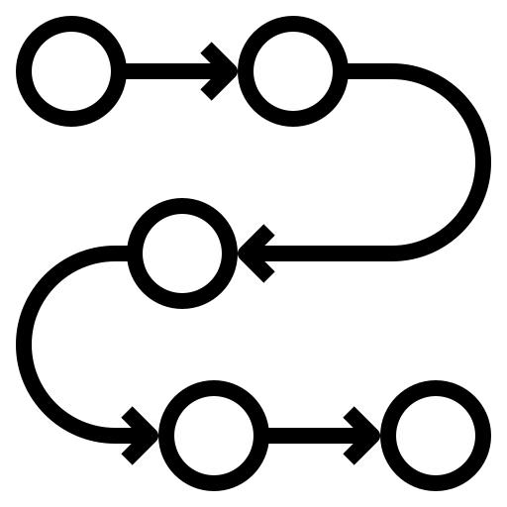

Triplet Generation: ALLEN NLP Model
Sentences labeled with
Semantic Roles
Triplets
Final Triplets
Preprocessed Paragraphs
Sentences
Coreference
Resolution
Filter
SRL BERT
Post-Process
Preprocess the input text to remove special characters, lemmatize, remove sentences without NER
Perform Coreference Resolution on a paragraph level
Ex. ‘Bitcoin is a cryptocurrency. It can be volatile.’ → ‘... Bitcoin can be volatile.’
SRL BERT labels semantic roles for each token of the sentence
Ex. ‘Bitcoin is a cryptocurrency.’ → ‘[ARG0] Bitcoin [V] is [ARG1] a cryptocurrency.’
Post-process to convert semantic roles to subject, verb, object and create triplets
Ex. (ARG0, V, ARG1) → (S, V, O) → (Bitcoin, is, a cryptocurrency)
Filter to choose triplets based on KnowText filtering

Slide 14
Triplet Generation: Stanford Open IE
Preprocessed Paragraphs
Sentences
Triplets
Final Triplets
Coreference
Resolution
Stanford OpenIE
Filter
Example: The biggest individual insider shareholder of Apple is Arthur Levinson, who has been the company's chair of the board since 2011
subject: biggest individual insider shareholder ; relation: is ; object: Arthur Levinson
subject: Levinson ; relation: owns ; object: 4.5 million shares of Apple stock
subject: Levinson ; relation: owns ; object: 4.5 million shares
Preprocess the input text to remove special characters, lemmatize, remove sentences without NER
Perform Coreference Resolution on a paragraph level
Stanford OpenIE extracts short clauses and maximally selects arguments to create candidate triples
Schema for the relation labels does not need to be specified in advance - ontology
Filter to choose triplets based on KnowText filtering

Slide 15
Ontology Construction

Slide 16
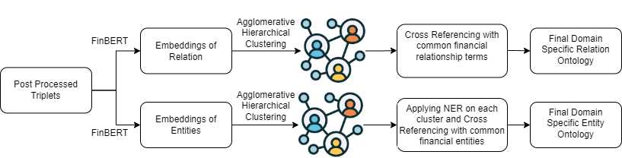
Ontology Construction
We generated both the relation ontology and entity ontology in a semi-automatic format which can be used to develop an ontology for different domains given different key terms.
We used triplets extracted from the models as the input and passed them through FinBert Embeddings to generate embeddings for every unique relation and entity separately.
We then applied Agglomerative Hierarchical Clustering on these embeddings to identify and group similar relations/entities.
We also cross-referenced the clusters with common domain-specific financial relationships to get the final relation ontology.
For generating final entity ontology, applied NER on the entity clusters and cross-referenced them with domain-specific financial entities.

Slide 17
Natural Language Question to SPARQL Query Conversion

Slide 18
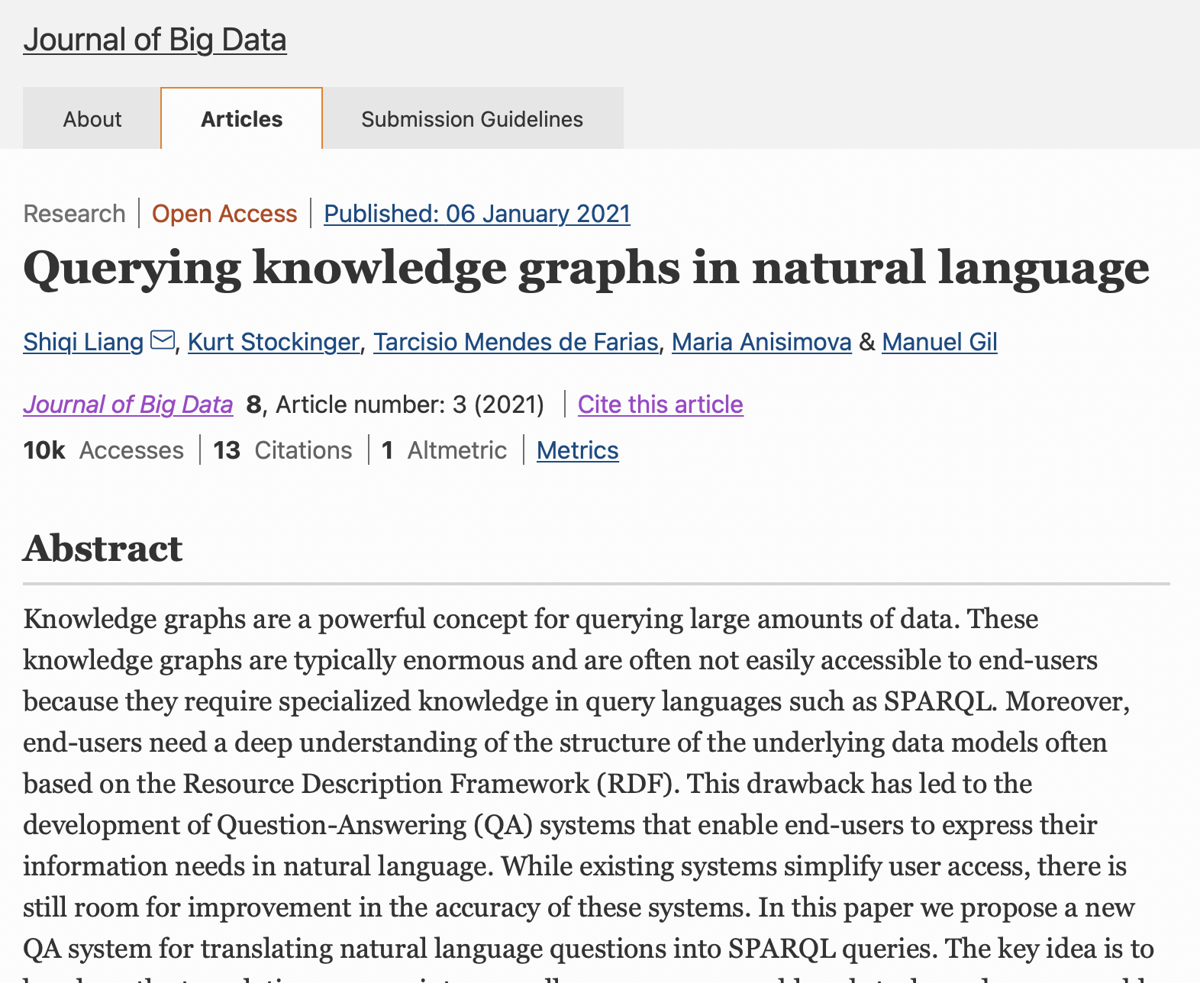

Slide 19
Overview
Natural Language Question (NLQ)
Query Template Classifier
Query Triple extraction
Query Triple mapping
SPARQL query construction
How many papers has Satish Banka written?
{Template 3,
Count question:
SELECT (COUNT(<O>) as ?COUNT)
WHERE {<S> <P> <O>.}
Relation: write
Entity: paper, Satish Banka
Mapped relation:
is_author_of
Mappen entity:
research_paper;
Satish_Banka
SELECT (COUNT(research_paper) as ?COUNT)
WHERE {
<Satish_Banka> <is_author_of>
<research_paper>.
}

Slide 20
Natural Language to SPARQL Query conversion
Query Template Classifier
Query Triple extraction
Query Triple mapping
SPARQL query construction
- Trained an XGBoost model on LCQuAD dataset
- Takes finBert embeddings of queries as input and classify them into 5 most used templates
- Accuracy: 77% on crypto related queries (and 82% on general questions in LCQuAD dataset)
- Limitations: Can’t classify templates outside the 5; accuracy can be improved using transfer learning
- Rule-based matching
- Relations: Performed dependency parsing to
extract dependent object
- Entities: Extracted noun
phrases
- Accuracy: 90%+
- Limitations: For handling complex queries, complex
rules need to be generated
- Used combination of Levenshtein distance & finBERT cosine similarity to map extracted triples to ontology triples
- The mapped relations and entities replace the placeholders in query templates
- All possible combinations of a query are generated and returned using the mapped triples
- Limitations: Many papers use a query ranking mechanism to find the most likely query; this implementation misses that

Slide 21
Appendix

Slide 22
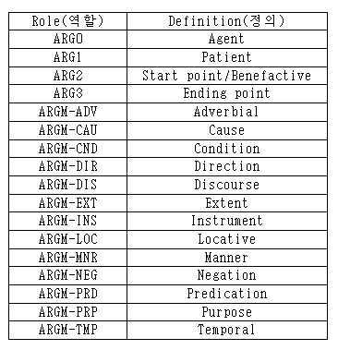
Semantic Role Labels

Slide 23
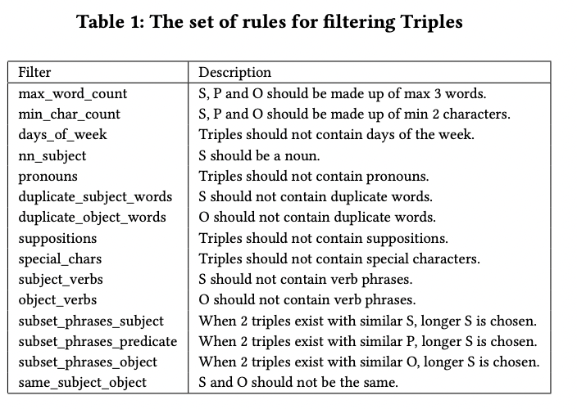
KnowText Filters

